Slide 1
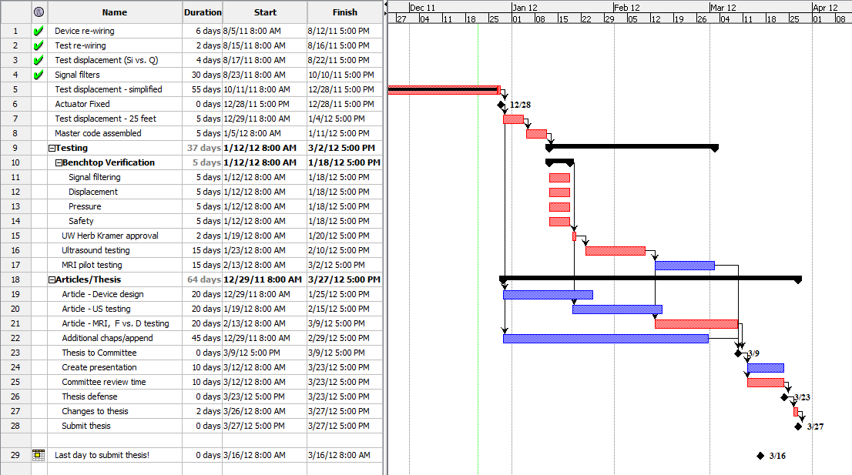
12/21/11 Schedule update

Slide 2
1/3/12 Re-assembly of actuator
128mm
Full retraction, ~ 0“
78.9mm
129.75mm
Full extension, 2.0019”
125mm
Shift CCW limit switch back ~4.75mm
Ensures a ~3mm safety zone before bottoming out piston in cylinder and destroying actuator components
4.75mm

Slide 3
1/3/12 Re-assembly of actuator - actual
128.45mm
Full retraction, ~ 0“
79.25mm
124.18mm
Full extension range = 45.598mm ( 1.769 inches )
~ 4.27 mm safety zone before bottoming out piston in cylinder and destroying actuator components

Slide 4
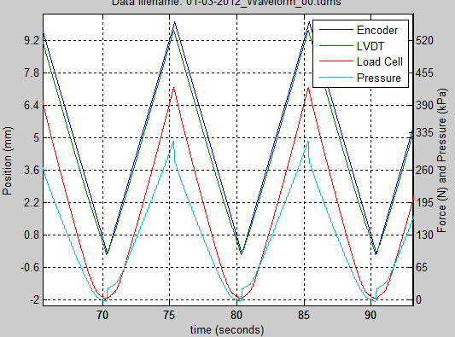
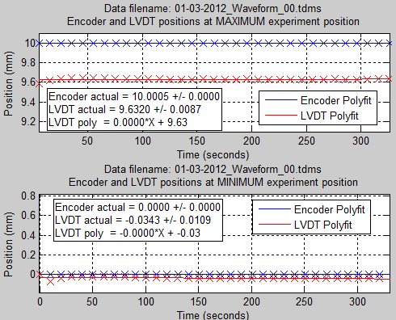
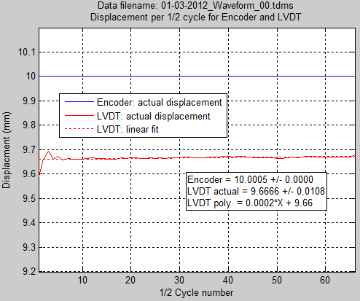
Displacement testing 01/03/12
“WaveformOutputTDMS_03c.m”, “Master_rev_14b…vi”
33 cycles, triangle @ 0.1Hz, 10.0 mm displacement, 2500 kHz sampling rate
Reattached actuator.
Leveled LVDT in two planes, filled, bled, pushed air back and forth.
Repositioned Load cell so that initial load was small (~9), using 4 springs.
Incremented actuator forward at 0.01mm until LVDT showed movement (moving average). Started experiment.

Slide 5
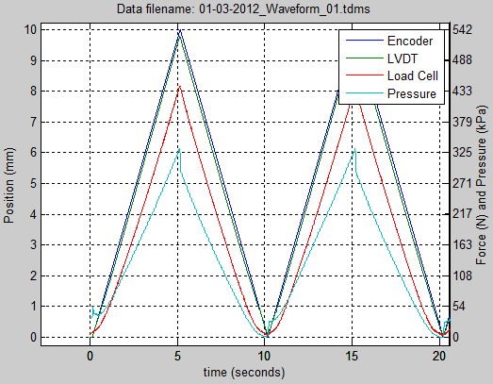
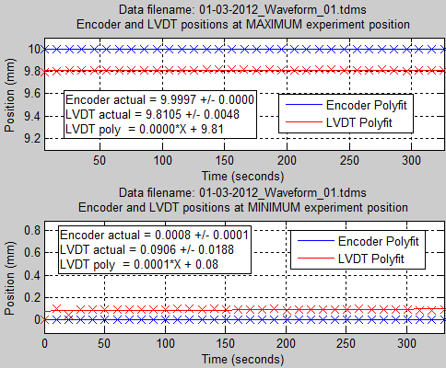
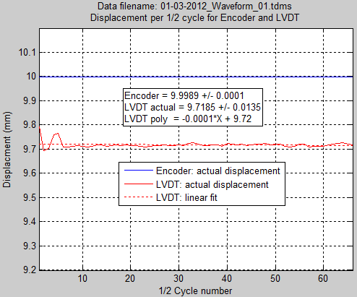
Displacement testing 01/03/12
“WaveformOutputTDMS_03c.m”, “Master_rev_14b…vi”
33 cycles, triangle @ 0.1Hz, 10.0 mm displacement, 2500 kHz sampling rate
Repositioned Load cell again, so that initial load was small (~7N), pressure ~4.5psi, using 4 springs.
Incremented actuator forward at 0.01mm until LVDT showed movement (moving average). Started experiment.

Slide 6
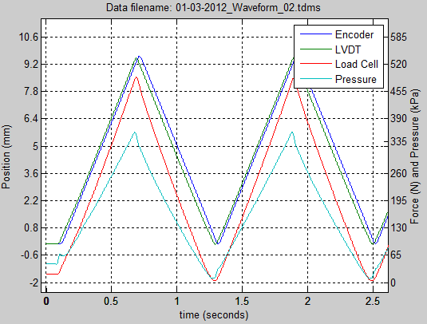
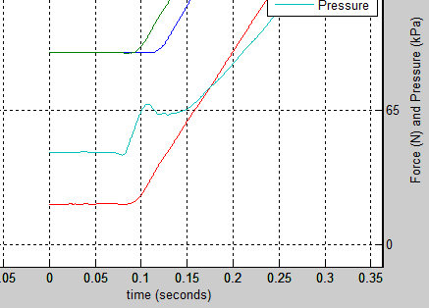
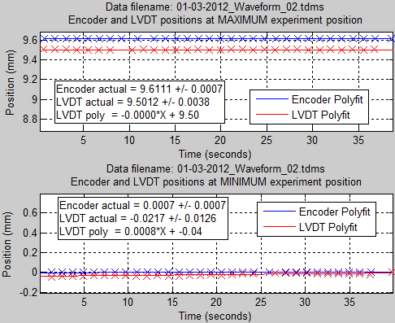
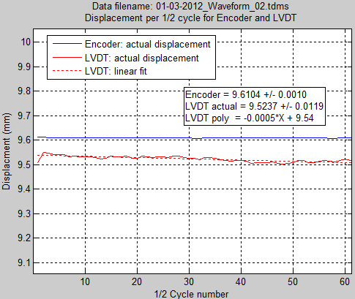
Displacement testing 01/03/12
“WaveformOutputTDMS_03c.m”, “Master_rev_14b…vi”
33 cycles, triangle @ 0.8Hz, 10.0 mm displacement, 2500 kHz sampling rate
Using 4 springs.
Advanced actuator after last test a full 1mm before starting test:
Load cell ~20N, pressure ~6.5 psi
Believe that actuator was hitting extension limit switch with each cycle, explaining 9.6 mm displacement.

Slide 7
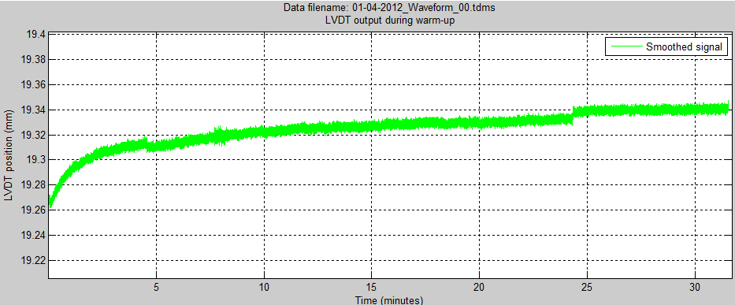
Displacement testing 01/04/12
“WaveformOutputTDMS_03c.m”, “Master_rev_14b…vi”
LVDT warm-up characteristics
Started LVDT after starting LabVIEW, noticed that moving average LVDT position was increasing, even though LVDT was stationary.
Ran for approximately 3 minutes before turning off power to LVDT and allowing to cool for 15 minutes.
Pushed air back and forth in system, advanced slave slightly (~1mm), then closed both valves and up-righted system.
No load on slave platen.
Then, ran this test. Still stationary, applied power to LVDT and allowed to sit until LVDT reading had sufficiently stabilized.
Use this time or more for future testing.
From spec sheet, Linearity: <0.2% FSO = 0.06mm
Based on this, allow at least 30 minutes of warm-up time for LVDT before testing.

Slide 8
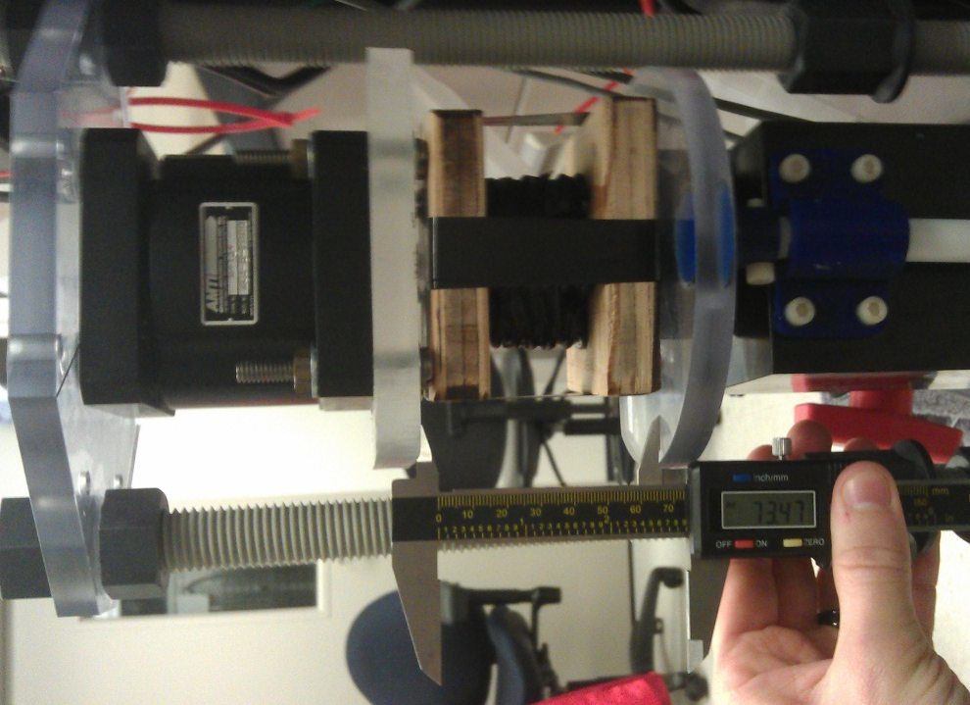
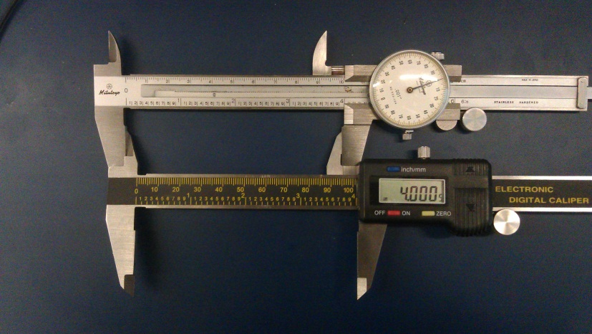
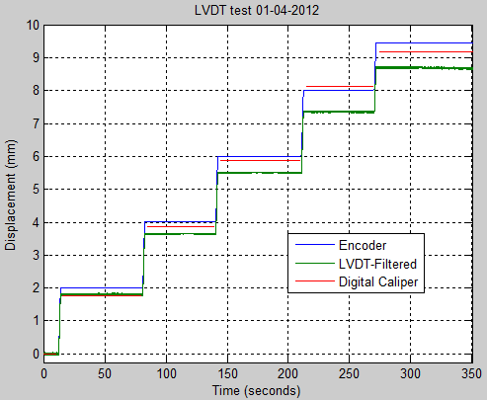
Displacement testing 01/04/12
“WaveformOutputTDMS_03c.m”, “Master_rev_14b…vi”
LVDT test
Didn’t change anything after letting system sit for awhile since previous test.
Slave was extended a small bit (~1mm). Cranked load cell with 4 springs down upon platen until load was ~127N.
Ran advance and pause test, measuring the distance between the slave platen and the load cell (stationary) with each movement.
AWESOME (sarcasm).
Run test first on LVDT, and if that pans out as accurate, then mount LVDT upon actuator in “permanent” fashion.

Slide 9
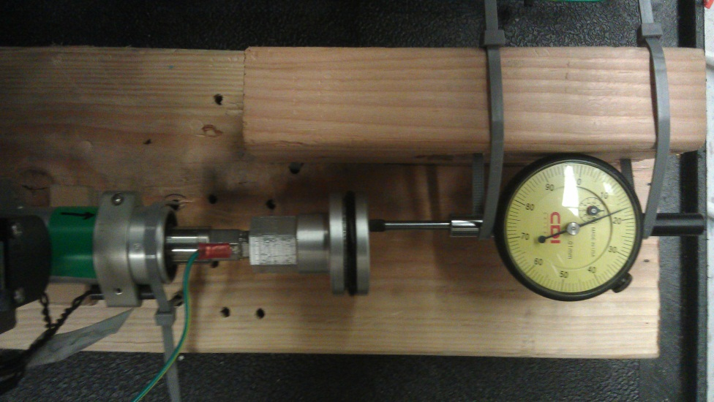
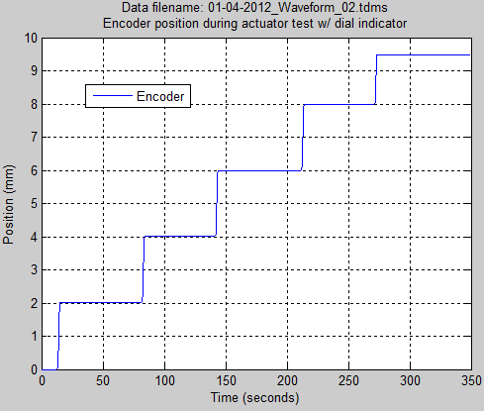
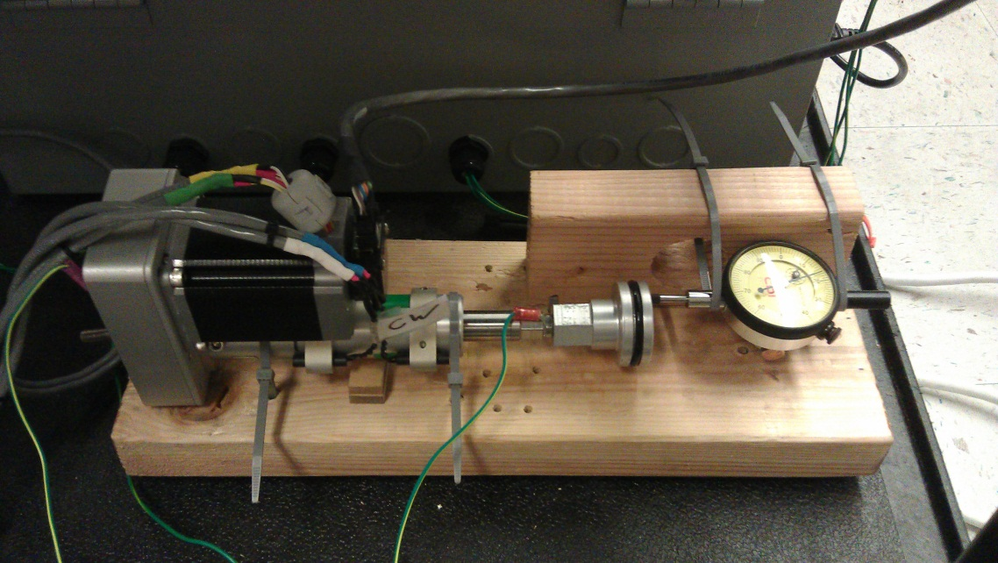
Actuator testing 01/04/12
“”, “Master_rev_14b…vi”
Used dial indicator to test actuator displacement
After advancing actuator to point that dial indicator had gone past zero (to 0.17mm), I advanced the actuator in 1mm increments.
The dial indicator didn’t deviate more than 0.01mm from 0.17mm with each incremental move.
The actuator is displacing the correct amount, at least with ~0 load on it.

Slide 10
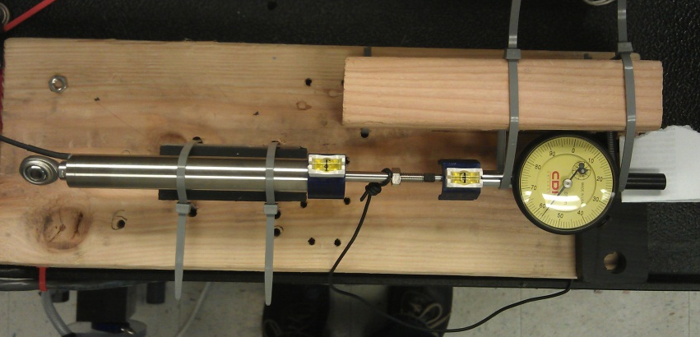
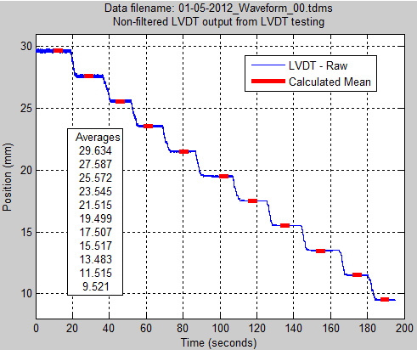
LVDT testing 01/05/12
“LVDT_dial_indicator_test.m”, “Master_rev_14b…vi”
After advancing LVDT by hand to point that dial indicator had gone past zero (to 0.59mm), I advanced the LVDT in ~2mm increments, holding in place for 5 seconds and then writing down dial indicator in notebook.
Post-processed LVDT data in Matlab, grabbed beginning of 5 seconds period (chosen by reviewing for flat signal area) and calculated mean of 5 seconds’ worth of data after beginning point.
LVDT is always within < 1% of dial indicator readout. That seems to be well within the tolerance of my test setup.

Slide 11
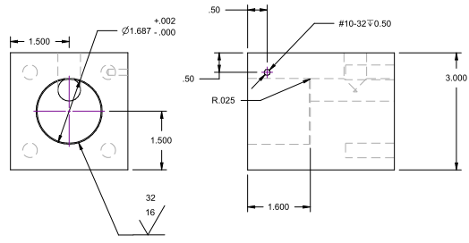
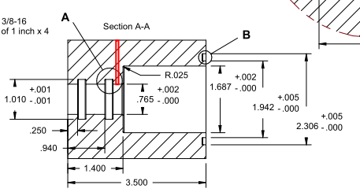
Displacement testing: 01/05/12
Master cylinder
Measured diameter = 1.660”
Slave cylinder
Measured diameter = 1.690”
Area Master/Area Slave cylinders = 2.1642/2.2432 = 0.965
Therefore, for every 10mm the master moves, the slave would move ~ 9.65mm
01_03_2012_01: .9719
01_03_2012_00: .9666

Slide 12
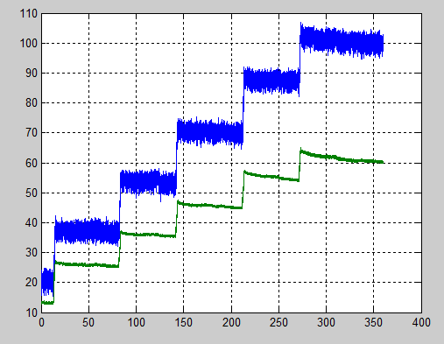
Pressure Transducer filter diagnostics: 01/05/12
100.8
87.71
70.49
53.99
61.18
55.2
36.44
45.59
35.9
20.45
26.72
13.4

Slide 13
Pressure Transducer filter diagnostics: 01/05/12
I think that I was reading the wrong DAQ channel in LabVIEW, one that wasn’t hooked to anything. But, due to ghosting (I think), there was an apparent reading there.
YEP, THAT WAS IT!

Slide 14
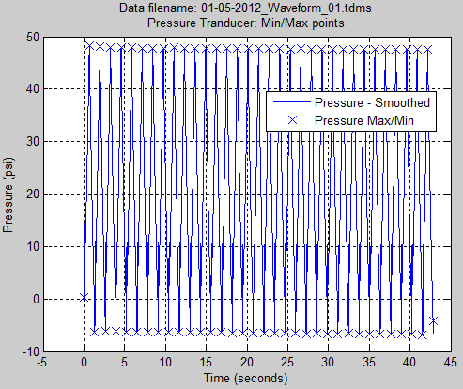
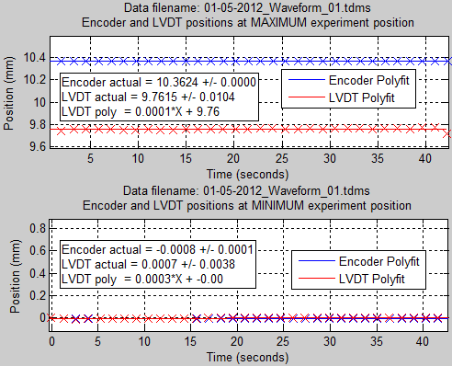
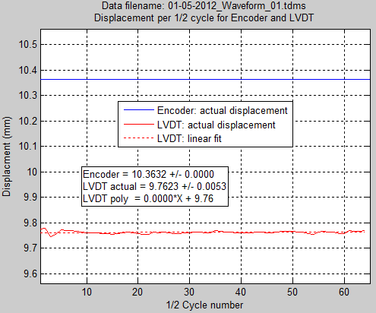
Displacement testing 01/05/12
“WaveformOutputTDMS_03c.m”, “Master_rev_14b…vi”
33 cycles, triangle @ 0.8Hz, 10.0 mm
(10.0mm x 1.036269 hydraulic factor) displacement, 2500 kHz sampling rate
Attached actuator, tightened aft-mount during vertical cycling.
Attached LVDT, leveled.
Filled, bled, ran a few slow cycles with valves open, transferred water w/ syringes, closed valves.
Repositioned Load cell with 4 springs, so that initial load was small (~5N)
Forgot to increment actuator forward.
Started experiment.
Pressure drops below 0 at completion of first cycle and stays down there.

Slide 15
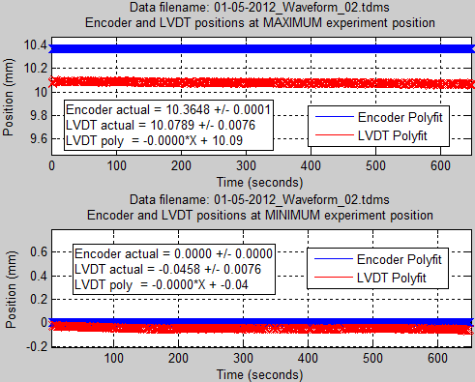
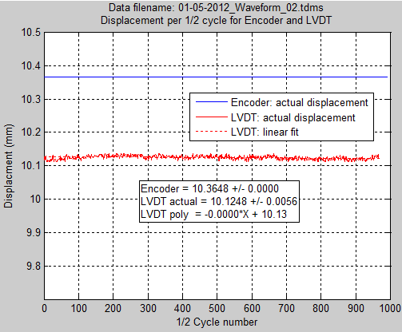
Displacement testing 01/05/12
“WaveformOutputTDMS_03c.m”, “Master_rev_14b…vi”
500 cycles, triangle @ 0.771Hz, 10.0 mm (10.0mm x 1.036269 hydraulic factor) displacement, 2500 kHz sampling rate
Started shortly after last test finished.
Incremented actuator forward at 0.1mm until LVDT, pressure, and load cell all showed definite movement. Started experiment.
Max position of platen within 0.79% of target of 10mm!

Slide 16
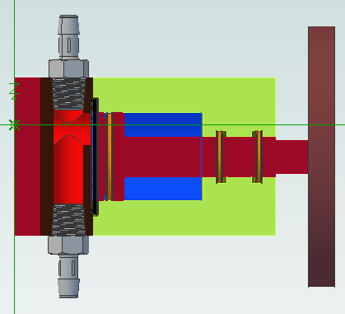
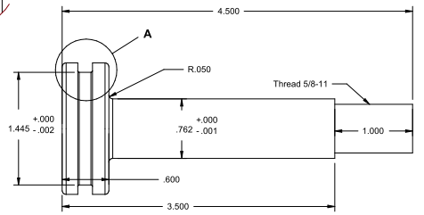
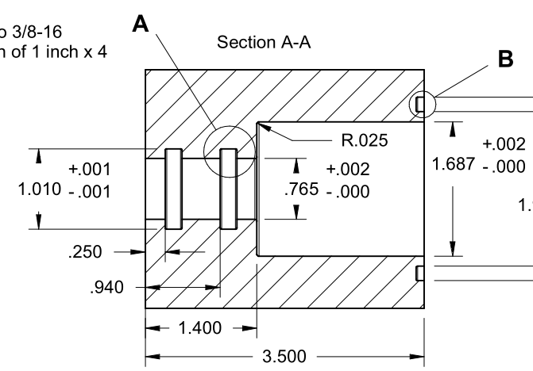
Slave springs 01/05/12
Playing around at this point, just in case
http://www.leespring.com/product_spec.asp?partnum=LL038050U40G&springType=P
Part Number LL 038 050 U40G
Outside Diameter 0.350 in
Hole Diameter 0.375 in
Approx. load at Solid 2.041 lb
Free Length 0.500 in
Spring Rate 5.46 lb/in
Rod Diameter 0.150 in
Radial Wall 0.082 in
Solid Heignt 0.127 in
Number of Coils 2.1
Total Coils 4.1
Color RESIN COLOR VIOLET
Material ULTEM
Radial Wall 0.082 in
Wire Thickness 0.030 in
2.1”
0.6”

Slide 17
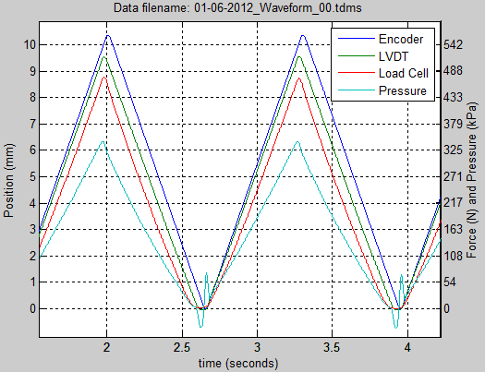
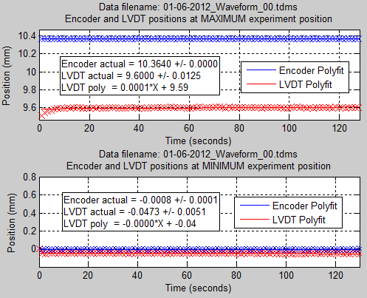
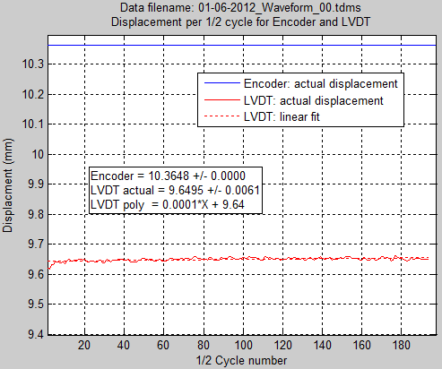
Displacement testing 01/06/12
“WaveformOutputTDMS_03c.m”, “Master_rev_14b…vi”
100 cycles, triangle @ 0.771Hz, 10.0 mm
(x 1.036269 hydraulic factor) displacement, 2500 kHz sampling rate
Did not change water. Tilted from vertical, extended master, moved water, withdrew master, ran a few slow cycles, closed valves.
Repositioned Load cell with 4 springs, so that initial load was small (~7N).
Advanced at 0.01mm until LVDT had advanced by 0.01mm.
Slave piston started initially bottomed out.
Started experiment.
Results not nearly as good as yesterday’s factored test. Water overnight has probably absorbed a lot of air (valves were open to syringes).

Slide 18
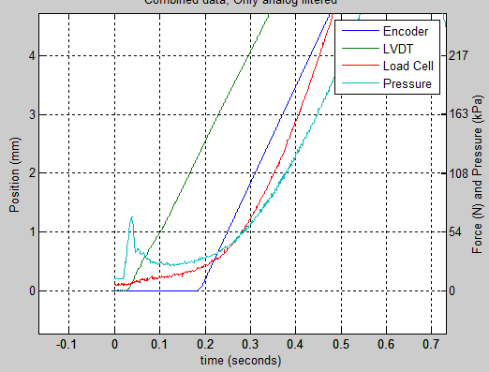
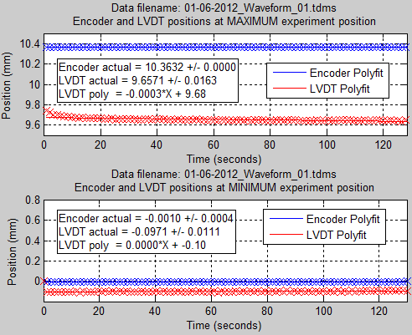
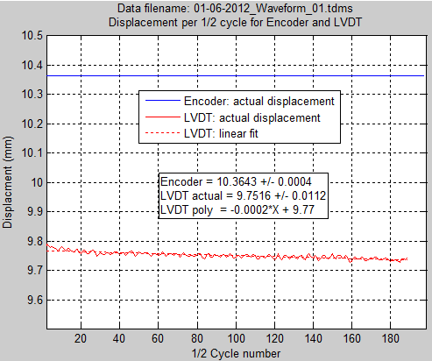
Displacement testing 01/06/12
“WaveformOutputTDMS_03c.m”, “Master_rev_14b…vi”
100 cycles, triangle @ 0.771Hz, 10.0 mm
(x 1.036269 hydraulic factor) displacement, 2500 kHz sampling rate
Same exact procedure as previous experiment, but used silicone instead of 4 springs.
Did not change water. Tilted from vertical, extended master, moved water, withdrew master, ran a few slow cycles, closed valves.
Repositioned Load cell with 4 springs, so that initial load was small (~7N).
Advanced at 0.01mm until LVDT had advanced by 0.01mm.
Slave piston started initially bottomed out.
Started experiment.
Ummmmm…..LVDT starts moving before encoder supposedly moves. That’s an issue.

Slide 19
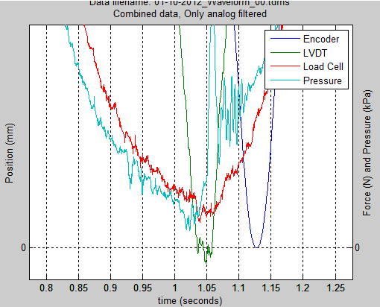
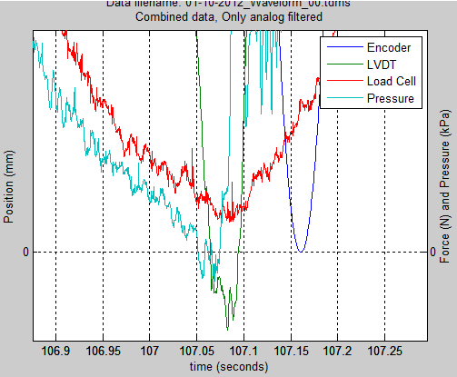
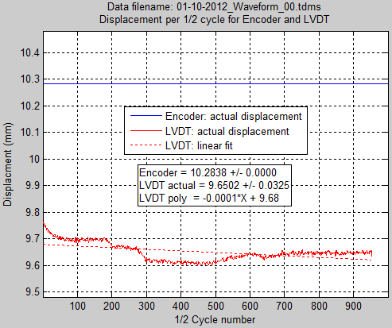
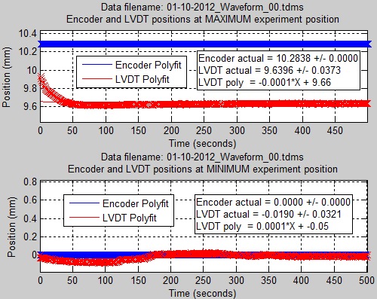
Displacement testing 01/10/12
“WaveformOutputTDMS_03c.m”, “Master_rev_14b…vi”
500 cycles, triangle @ 1.0 Hz, 10.0 mm (x 1.0281573 hydraulic factor) displacement, 2500 kHz sampling rate
Refilled, re-bled, lowered load cell w/ silicon until ~8N, incremented until LVDT had moved 0.05mm
Started experiment.
First 1.0 Hz in a long time.
Adjusted hydraulic factor based on linear relationship of max platen displacement with previous hydraulic factor = 1.036269.
Could see same movement described on next slide.
Max position of platen within -3.6% of target of 10mm

Slide 20
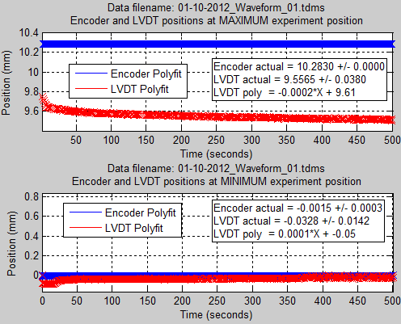
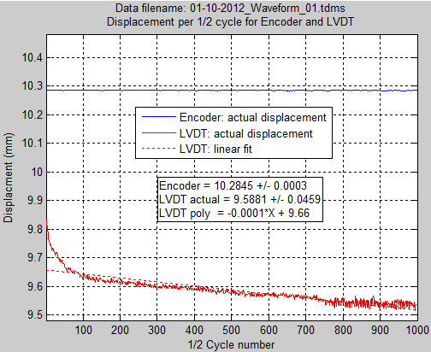
Displacement testing 01/10/12
“WaveformOutputTDMS_03c.m”, “Master_rev_14b…vi”
500 cycles, triangle @ 1.0 Hz, 10.0 mm (x 1.0281573 hydraulic factor) displacement, 2500 kHz sampling rate
Opened valves, cycled piston slowly, re-transferred water, no bubbles, extended slave by 0.5mm from bottomed out, lowered load cell w/ silicon until ~7N, incremented until LVDT had moved 0.05mm
Started experiment.
Repeat of last test except slightly extended slave at start.
Took short video during testing, you can clearly see movement at acrylic back plate, threaded rods, and acrylic plate between rods that load cell attaches to. Plastic is viscoelastic… http://tinyurl.com/87qc3ko
Max position of platen within -4.4% of target of 10mm

Slide 21
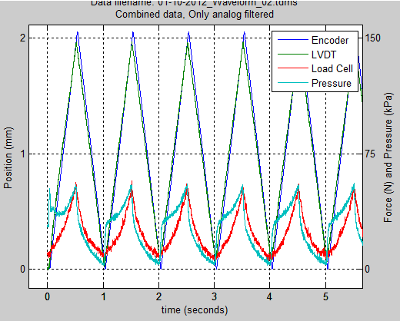
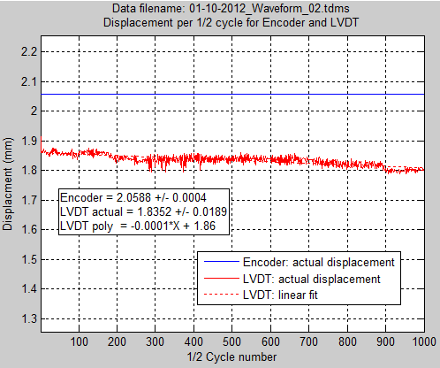
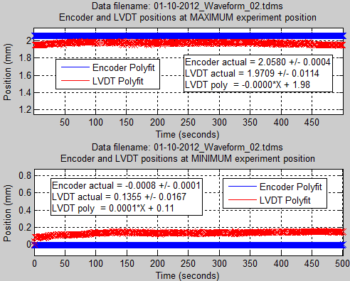
Displacement testing 01/10/12
“WaveformOutputTDMS_03c.m”, “Master_rev_14b…vi”
500 cycles, triangle @ 1.0 Hz, 2.0 mm (x 1.0281573 hydraulic factor) displacement, 2500 kHz sampling rate
Opened valves, did not cycle pistons or move starting position from where last test ended, re-transferred water, no bubbles, extended slave by 0.5mm from bottomed out, lowered load cell w/ silicon until ~7N, incremented until LVDT had moved 0.05mm
Started experiment.
Repeat of last test except only 2mm at 1.0Hz.
Max position of platen within -1.5% of target of 2mm

Slide 22
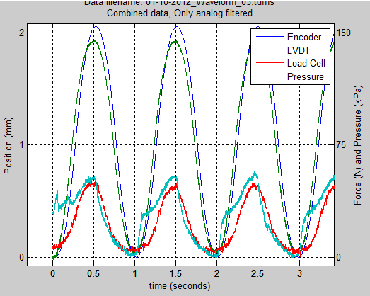
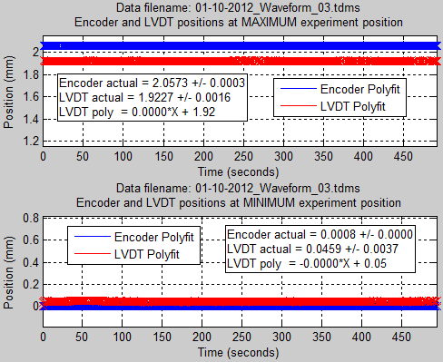
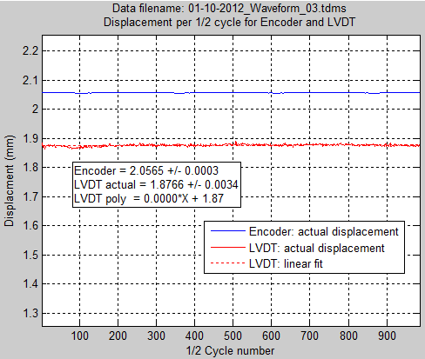
Displacement testing 01/10/12
“WaveformOutputTDMS_03c.m”, “Master_rev_14b…vi”
500 cycles, sine @ 1.0 Hz, 2.0 mm (x 1.0281573 hydraulic factor) displacement, 2500 kHz sampling rate
(acc = 21.2549 rev/s/s, vel = 5.2253 rev/s)
Opened valves, did not cycle pistons or move starting position from where last test ended, re-transferred water, no bubbles, extended slave by 0.5mm from bottomed out, lowered load cell w/ silicon until ~7N, incremented until LVDT had moved 0.05mm
Started experiment.
Same as last, but 2.0mm sine instead of triangle.
Max position of platen within -3.87% of target of 2mm

Slide 23
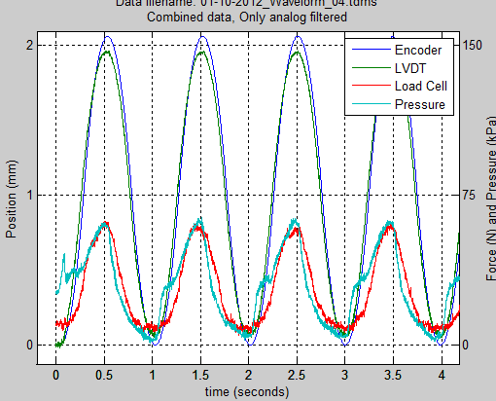


Displacement testing 01/10/12
“WaveformOutputTDMS_03c.m”, “Master_rev_14b…vi”
500 cycles, sine @ 1.0 Hz, 2.0 mm (x 1.0281573 hydraulic factor) displacement, 2500 kHz sampling rate
(acc = 21.2549 rev/s/s, vel = 5.2253 rev/s)
Opened valves, did not cycle pistons or move starting position from where last test ended, re-transferred water, no bubbles, extended slave by 0.5mm from bottomed out, lowered load cell w/ silicon until ~7N, incremented until LVDT had moved 0.05mm
Started experiment.
Exact same test. Checking repeatability.
Max position of platen within -2.4% of target of 2mm

Slide 24



Displacement testing 01/11/12
“WaveformOutputTDMS_03c.m”, “Master_rev_14b…vi”
200 cycles, triangle @ 1.0 Hz, 10.0 mm (x 1.0281573 hydraulic factor) displacement, 2500 kHz sampling rate
New water, bled, cycled piston, cycled water with syringes, extended slave by 0.5mm from bottomed out, no resistance on platen, incremented until LVDT had moved 0.05mm.
Started experiment.
Repeat of 1-10_01, without load on platen.
Max position of platen within +1.1% of target of 10mm

Slide 25

Displacement testing 01/11/12
Test on previous slide shows LVDT leading encoder by nearly 0.5 seconds.
As a double-check, I opened the TDMS file in LabVIEW with a TDMS reader, to ensure that it wasn’t MATLAB doing something weird. Looks the same.
12-15-2011_01 is from the LVDT strapped onto the encoder; Lag of LVDT behind encoder should be (theoretically) zero, there is actually 0.01455 seconds lag.

Slide 26




Displacement testing 01/11/12
Same everything as before, didn’t do a thing to it, just ran 50 cycles to observe with my eyes; by sight, they were in sync. LVDT is ahead of encoder by approx. 0.011 seconds, set at usual 250 samples/collection, 2500 Hz rate.
Changed LabVIEW to acquire 1000 samples/collection, same data rate. New time lead is approximately 0.02 seconds.
Changed to acquire 2500 samples/collection, same data rate. New time lead is 0.022 seconds.
Changed to 250 samples/collection, 1000 samples second. New time lead is 0.022 seconds.
Changed to 25 samples/collection, 1000 samples/second. ERROR IN LABVIEW, ATTEMPTED TO READ SAMPLES NO LONGER AVAILABLE.

Slide 27



Displacement testing 01/11/12
“WaveformOutputTDMS_03c.m”, “Master_rev_14b…vi”
500 cycles, triangle @ 1.0 Hz, 10.0 mm (x 1.0281573 hydraulic factor) displacement, 2500 kHz sampling rate
New water, bled, cycled piston, cycled water with syringes, extended slave by 0.5mm from bottomed out, silicone on platen, lowered load cell until ~7N, then incremented until LVDT had moved 0.05mm.
Using new metal reinforcement straps to prevent movement.
Started experiment.
Still seeing some movement, but reduced.
Whole thing: http://youtu.be/J1iTUYA6zOE
Close-up of bottom: http://youtu.be/TS63VTdqq0U
Max position of platen within +0.65% of target of 10mm

Slide 28



Displacement testing 01/11/12
“WaveformOutputTDMS_03c.m”, “Master_rev_14b…vi”
500 cycles, triangle @ 1.0 Hz, 10.0 mm (x 1.0281573 hydraulic factor) displacement, 2500 kHz sampling rate
New water, bled, cycled piston, cycled water with syringes, extended slave by 0.5mm from bottomed out, silicone on platen, lowered load cell until ~7N, then incremented until LVDT had moved 0.05mm.
Using new metal reinforcement straps to prevent movement.
Started experiment.
Repeat of previous test, ~30 minutes after previous completed.
Max position of platen within -1.1% of target of 10mm

Slide 29



Displacement testing 01/11/12
“WaveformOutputTDMS_03c.m”, “Master_rev_14b…vi”
500 cycles, triangle @ 1.0 Hz, 10.0 mm (x 1.0281573 hydraulic factor) displacement, 2500 kHz sampling rate
New water, bled, cycled piston, cycled water with syringes, extended slave by 0.5mm from bottomed out, silicone on platen, lowered load cell until ~7N, then incremented until LVDT had moved 0.05mm.
Using new metal reinforcement straps to prevent movement.
Started experiment.
Repeat of previous test, ~10 minutes after previous completed.
Max position of platen within -0.2% of target of 10mm

Slide 30





Encoder testing 01/13/12
“WaveformOutputTDMS_03c_EncAI.m”, “Master_rev_14c_encoderAI.vi”, 2500 kHz sampling rate
Added lines from PFI channels 8&10 (Encoder channels A&B, respectively) to Analog inputs 4&12. Added those two new channels into LabVIEW AI acquisition, adapted MATLAB to read in new TDMS waveform and plot.
Digitized EncA and EncB into either 5 or 0 volts from analog values.
Shifted 5 and 0 volt data points to 0 and -0.1 volts for ease of viewing on graph.
Three different start of movement points (circled, right) analyzed.
Each analyzed point shows a lag of the standard LabVIEW encoder DAQMx readout behind the analog input transitioning of 0.0256 seconds, or 64 samples’ worth (at 2500Hz).
t_{lag} = 0.0256 seconds
t_{lag} = 0.0256 seconds
t_{lag} = 0.0256 seconds
t = 0.8372
t = 14.3884
t = 44.2072
t = 44.2328
t = 0.8116
t = 14.3628

Slide 31


New test fixture 01/13-17/12
Using the existing 80/20 load cell calibration frame, I designed a new test fixture:
New load cell mounting plate needed for the AMTI load cells (included center hole so gold standard can still be swapped in
Slave cylinder can be adjusted up/down, back/forward
Threaded rod with plastic puck at end will be snugged up against piston axis to put proper preload on loadcell and to carry bulk of load into the 80/20 frame
Features another revision to LVDT mounting mechanism (old mount interfered with new fixture)

Slide 32

Encoder testing 01/19/12
“WaveformOutputTDMS_03c_EncAI.m”, “Master_rev_14d_start_trigger.vi”, 2500 kHz sampling rate
Per NI Forum recommendation, switched DAQmx Start Task order from:
Clock Source
Encoder
Analog Inputs
to
Encoder
Analog Inputs
Clock Source
From forum: “I think I've got it.
Take a look at the portion of the code where you are starting your tasks:
The clock is starting first, then the encoder, then the analog task. The amount of time between the starting of tasks is completely software-defined and thus non-deterministic. Since the encoder task is starting before the analog task and the clock has already been started, it will pick up more samples during the time you are waiting for the analog task to start. This will appear as a lag since you are matching the graphs sample-by-sample.
The solution is to start the clock source after starting both the encoder and the waveform task.
Also, I notice you are not arming your encoder. It won't be a problem if your actuator is inactive during the startup time of the measurement application, but if it is moving this could also cause the two measurements to start out out-of-synch. The solution in this case would be to use the start trigger from your analog task as the arm start trigger for your encoder task. In this case, you would want to start your tasks in the following order: 1) Encoder 2) Analog In 3) Clock (Counter Out).
Best Regards, John Passiak

Slide 33




Encoder testing 01/19/12, cont.
“WaveformOutputTDMS_03c_EncAI.m”, “Master_rev_14d_start_trigger.vi”, 2500 kHz sampling rate
Ran a simple test, still measuring encoder channels both digitally and analog.
LVDT data is meaningless, as LVDT is lying next to slave platform unattached.
Now, digital encoder signal starts moving at completion of first transition of either channel A or B.
For now, I’ll keep acquiring those signals in analog as well, until I’m confident that this has completely solved all problems.

Slide 34





New test rig and 30’ tubing setup: 01/24/12

Slide 35




New test rig and 30’ tubing setup: 01/24/12
Fill valve
Syringe B
C3
Syringe C
C1
C2
B1
A1
Pressure Transducer
Syringe A
Bleed Valves
System High Point
B3
A3
B2
A2
Linear Actuator
Drain valve
Master Cylinder
Slave Cylinder
Hydraulic Tubing Lines
Main Pressure line
Auxiliary lines
Bucket

Slide 36



Displacement testing 01/24/12
“WaveformOutputTDMS_03c_EncAI.m”, “Master_rev_14d…vi”
500 cycles, triangle @ 1.0 Hz, 2.0 mm (x 1.0281573 hydraulic factor) displacement, 2500 kHz sampling rate
Filled w/ water, involving pulling water from top syringe with water
Chased bubbles from tubing up into slave
Cycled master @ 0.1 hz for 15 cycles, tapping/readjusting everything and also transferring water back and forth between syringes
Re-tapped tubing, chased any bubbles to slave (didn’t see any), pushed water again.
Cycled master 10 cycles, transferred more water
NO BUBBLES SEEN AT THIS POINT
extended slave by 0.5mm from bottomed out, silicone on load cell
Advanced screw until about ~9N
incremented 0.01mm until LVDT had moved 0.05mm (encoder moved .27mm)
Started test.
Saw on bubble (size of a tiny pea) in the line below the slave, no others.
Max position of platen within +5.5% of target

Slide 37



Displacement testing 01/24/12
“WaveformOutputTDMS_03c_EncAI.m”, “Master_rev_14d…vi”
500 cycles, triangle @ 1.0 Hz, 5.0 mm (x 1.0281573 hydraulic factor) displacement, 2500 kHz sampling rate
Water sat for ~2 hours
Chased bubbles from tubing up into slave
Cycled master @ 0.1 hz for 10 cycles, tapping/readjusting everything and also transferring water back and forth between syringes
Re-tapped tubing, chased any bubbles to slave (didn’t see any), pushed water again.
Cycled master 10 cycles, transferred more water
NO BUBBLES SEEN AT THIS POINT
extended slave by 0.5mm from bottomed out, silicone on load cell
Advanced screw until about ~9N
incremented 0.01mm until LVDT had moved 0.05mm (encoder moved ~ 0.2mm)
Started test.
Saw 2 small bubbles,1 in the line below the slave, 1 near high-point.
Max position of platen within -15.2% of target

Slide 38



Displacement testing 01/24/12
“WaveformOutputTDMS_03c_EncAI.m”, “Master_rev_14d…vi”
500 cycles, triangle @ 1.0 Hz, 10.0 mm (x 1.0281573 hydraulic factor) displacement, 2500 kHz sampling rate
Water sat for ~15 minutes
Cycled master @ 0.1 hz for 10 cycles, tapping/readjusting everything and also transferring water back and forth between syringes
NO BUBBLES SEEN AT THIS POINT (previous testing had shown some bubbles “forming” at high point with a bleed followed by several cycles under pressure, and another bleed)
extended slave by 0.5mm from bottomed out, silicone on load cell
Advanced screw until about ~9N
incremented 0.01mm until LVDT had moved 0.05mm
Started test.
-Went fine for a bit, no bubbles noticed
-All of a sudden, stepper started making entirely different noise, as though it had changed speed. I killed the power to the stepper as fast as I could.
-Stepper motor was not hot after I stopped it.
-As though the load on it was too high, but load at that point was 150N < than max

Slide 39


Displacement testing 01/24/12
“WaveformOutputTDMS_03c_EncAI.m”, “Master_rev_14d…vi”
100 cycles, triangle @ 0.2 Hz, 10.0 mm (x 1.0281573 hydraulic factor) displacement, 2500 kHz sampling rate
Water sat for ~15 minutes
Cycled master @ 0.1 hz for 10 cycles, tapping/readjusting everything and also transferring water back and forth between syringes
NO BUBBLES SEEN AT THIS POINT (previous testing had shown some bubbles “forming” at high point with a bleed followed by several cycles under pressure, and another bleed)
extended slave by 0.5mm from bottomed out, silicone on load cell
Advanced screw until about ~9N
incremented 0.01mm until LVDT had moved 0.05mm
Started test.

Slide 40



Displacement testing 01/25/12
“WaveformOutputTDMS_03c_EncAI.m”, “Master_rev_14d…vi”
250 cycles, triangle @ 1.0 Hz, 5.0 mm (x 1.0281573 hydraulic factor) displacement, 2500 kHz sampling rate
Fresh water
Cycled master @ 0.1 hz for 10 cycles, tapping/readjusting everything and also transferring water back and forth between syringes
NO BUBBLES SEEN AT THIS POINT
extended slave by 0.5mm from bottomed out, silicone on load cell
Advanced screw until about ~8N
incremented 0.01mm until LVDT had moved 0.05mm
Started test.
Immediately saw bubble at high point, none at slave high point

Slide 41



Displacement testing 01/25/12
“WaveformOutputTDMS_03c_EncAI.m”, “Master_rev_14d…vi”
250 cycles, sine@ 1.0 Hz, 5.0 mm (x 1.0281573 hydraulic factor) displacement, 2500 kHz sampling rate
Started ~10 minutes after previous finished.
Did not re-bleed or transfer water, or remove air bubble
extended slave by 0.5mm from bottomed out, silicone on load cell
Advanced screw until about ~8N
incremented 0.01mm until LVDT had moved 0.05mm
Started test.
Immediately saw bubble at high point, none at slave high point

Slide 42


Displacement testing 01/25/12
“WaveformOutputTDMS_03c_EncAI.m”, “Master_rev_14d…vi”
250 cycles, triangle/sine @ 1.0 Hz, 5.0 mm (x 1.0281573 hydraulic factor) displacement, 2500 kHz sampling rate
Direct comparison of Load Cell and Pressure Transducer readings in Triangle and Sine wave displacements (previous 2 slides)
Load Cell
Pressure Transducer

Slide 43



Displacement testing 01/25/12
“WaveformOutputTDMS_03c_EncAI.m”, “Master_rev_14d…vi”
250 cycles, triangle @ 1.0 Hz, 5.0 mm (x 1.0281573 hydraulic factor) displacement, 2500 kHz sampling rate
Started ~1 hour after previous finished.
Duct-taped tubing to floor, cart, itself: in order to restrain it’s movement
no re-bleed or transfer water, or remove air bubble
Advanced screw until about ~8N
incremented 0.01mm until LVDT had moved 0.05mm
Started test.

Slide 44



Displacement testing 01/25/12
“WaveformOutputTDMS_03c_EncAI.m”, “Master_rev_14d…vi”
250 cycles, sine @ 1.0 Hz, 5.0 mm (x 1.0281573 hydraulic factor) displacement, 2500 kHz sampling rate
Started ~5minutes after previous finished.
Duct-taped tubing to floor, cart, itself: in order to restrain it’s movement
no re-bleed or transfer water, or remove air bubble
Advanced screw until about ~8N
incremented 0.01mm until LVDT had moved 0.05mm
Started test.

Slide 45




Displacement testing 01/25/12
“WaveformOutputTDMS_03c_EncAI.m”, “Master_rev_14d…vi”
250 cycles, triangle/sine @ 1.0 Hz, 5.0 mm (x 1.0281573 hydraulic factor) displacement, 2500 kHz sampling rate
Direct comparison of Load Cell and Pressure Transducer readings in Triangle and Sine wave displacements (last 4 tests)
Triangle wave
Sine wave

Slide 46



Displacement testing 01/25/12
“WaveformOutputTDMS_03c_EncAI.m”, “Master_rev_14d…vi”
50 cycles, triangle @ 0.1 Hz, 5.0 mm (x 1.0281573 hydraulic factor) displacement, 2500 kHz sampling rate
Started ~30 minutes after previous finished.
Duct-taped tubing to floor, cart, itself: in order to restrain it’s movement
no re-bleed or transfer water, or remove air bubble
Advanced screw until about ~8N
incremented 0.01mm until LVDT had moved 0.05mm
Started test.

Slide 47



Displacement testing 01/25/12
“WaveformOutputTDMS_03c_EncAI.m”, “Master_rev_14d…vi”
50 cycles, sine @ 0.1 Hz, 5.0 mm(x 1.0281573 hydraulic factor) displacement, 2500 kHz sampling rate
Started ~5 minutes after previous finished.
Duct-taped tubing to floor, cart, itself: in order to restrain it’s movement
no re-bleed or transfer water, or remove air bubble
Advanced screw until about ~8N
incremented 0.01mm until LVDT had moved 0.05mm
Started test.

Slide 48


Displacement testing 01/25/12
“WaveformOutputTDMS_03c_EncAI.m”, “Master_rev_14d…vi”
50 cycles, triangle/sine @ 0.1 Hz, 5.0 mm(x 1.0281573 hydraulic factor) displacement, 2500 kHz sampling rate
Direct comparison of Load Cell and Pressure Transducer readings in Triangle and Sine wave displacements (last 2 tests)
Duct-taped tubing to floor, cart, itself: in order to restrain it’s movement
Load Cell
Pressure Transducer

Slide 49

Displacement testing 01/25/12
“WaveformOutputTDMS_03c_EncAI.m”, “Master_rev_14d…vi”
Ramp and hold, ramp and hold w/ 2000 rev/s/s, 5(?) rev/s settings
Direct comparison of Load Cell and Pressure Transducer readings in Triangle and Sine wave displacements (last 2 tests)
Duct-taped tubing to floor, cart, itself: in order to restrain it’s movement

Slide 50



Displacement testing 01/27/12
“WaveformOutputTDMS_03c_EncAI.m”, “Master_rev_14d…vi”
250 cycles, sine @ 0.682 Hz, 5.0 mm(x 1.0281573 hydraulic factor) displacement, 2500 kHz sampling rate
Fresh water, used some red food coloring which does help to see air bubbles.
Started slave bottomed out (accidentally).
No duct-tape restraining tubing.
Did best job I could to bleed system, tapping, cycling master with valves open,
Closing far valve and drawing vacuum w/ each syringe, more tapping, etc.
Did not see any bubbles, started experiment, could see some small bubbles in
Coils on the floor. Tapped them towards high point (during experiment).
Forgot to convert Matlab-generated Acc/Vec into rev/s/s and rev/s:
Explains measured cycle rate of 0.682

Slide 51



Displacement testing 01/27/12
“WaveformOutputTDMS_03c_EncAI.m”, “Master_rev_14d…vi”
250 cycles, sine @ 0.5 Hz, 5.0 mm(x 1.0281573 hydraulic factor) displacement, 2500 kHz sampling rate
Conducted ~20 minutes after previous finished.
Same water, no transfer.
No duct-tape restraining tubing.
From previous, re-ratioed master/slave ratio to bump up output to 5.0mm
Ratio from 1.028 to 1.3822, master moving 6.911mm.
Also, remembered to convert mm/s to rev/s
Opened valve above slave, Moved slave to a bit extended from bottomed out
Had to open valve above master, extend to limit, then retract to get the distance I needed

Slide 52




DIY Pressure snubbers 01/29/12
grid_3_.5790_area_left_over_total_area.AD_PRT
37 holes @ 0.04” (#60 drill bit)
As designed, approximately 42% porous
To be installed at end of long runs of tubing (high point and just
before slave cylinder)
Black plastic clamps will keep them in place inside the tubing

Slide 53



Displacement testing 01/30/12
“WaveformOutputTDMS_03c_EncAI.m”, “Master_rev_14d…vi”
100 Sine wave @ 0.5 Hz, 6.911mm (master displacement)
Filled w/ fresh water, bled lines, pulled vacuum in each section and
saw a lot of air coalescing near high point.
No duct-tape restraining tubing.
Left master moving @ 6.911mm, doesn’t really matter.
Slave intentionally started bottomed-out.

Slide 54



Displacement testing 01/30/12
“WaveformOutputTDMS_03c_EncAI.m”, “Master_rev_14d…vi”
250 Sine wave @ 0.5 Hz, 6.911mm (master displacement)
Same water as previous, run ~ 5 minutes later. Opened high-point and slave valves to equalize pressure.
No duct-tape restraining tubing.
Left master moving @ 6.911mm, doesn’t really matter.
Opened valve above slave, Moved slave to a bit extended from bottomed out
Accidentally went for 250 cycles instead of 100 (only analyze first 100).

Slide 55



Displacement testing 01/30/12
“WaveformOutputTDMS_03c_EncAI.m”, “Master_rev_14d…vi”
250 Sine wave @ 0.5 Hz, 6.911mm (master displacement)
Same water as previous, run ~ 5 minutes later. Opened high-point and slave valves to equalize pressure.
No duct-tape restraining tubing.
Left master moving @ 6.911mm, doesn’t really matter.
Re-bottomed out slave, to ensure that 1st run vs. 3rd run differences are minimal.
Due to incremental CCW before each test, this test might have hit the CCW limiter on the top end.

Slide 56



Displacement testing 01/30/12
“WaveformOutputTDMS_03c_EncAI.m”, “Master_rev_14d…vi”
250 Sine wave @ 0.5 Hz, 6.911mm (master displacement)
Same water as previous, run ~ 15 minutes later. Opened high-point and slave valves to equalize pressure.
No duct-tape restraining tubing.
Left master moving @ 6.911mm, doesn’t really matter.
Extended master all the way with open valves, re-backed off the full distance.
Extended the slave a lot (~XXX mm), further than ever before,
then just like all other tests this morning I readjusted slave so that load cell read about 7N
incremented actuator forward at 0.01mm until LVDT showed 0.05mm of movement

Slide 57







Displacement testing 01/30/12
Times shifted various amount to avoid data overlap.
SHAPE OF CURVES AND LOCAL MINIMA/MAXIMA ARE WHAT PLOTS CONVEY
Conclusions
Initial bottomed-out test (00, blue) shows greatest spike after starting extension from disp. = 0
Initial bottomed-out also shows greatest negative pressure at disp. = 0
Continue to start w/ slave extended by ~ 0.5mm.
Load Cell comparison
Load Cell comparison
Load Cell comparison

Slide 58

Pressure snubber testing 01/30/12
Because it doesn’t seem to be too far off, use actuator displacement of 6.911000
Run 3 simulated annealing optimizations, starting with broad bounds and narrowing based on 1st results, and trying multiple starting points.
mm/sec Acc. Vel. RMS
0.1 Hz: 1.0559945795790424 2.211466885071977 0.17199553367867745
1.263957463795869 2.041862022056684 0.025259352169373295
1.2441476569609413 2.066349727284884 0.02412927501265966
0.5 Hz: 31.723992346009123 10.237746152343611 0.026430259438941114
31.148930228810094 10.340777249044171 0.023392165137497332
30.428670267669087 10.4532784404329 0.0301536087848017
1.0 Hz: 129.46507112570106 20.320501858273147 0.03332483359699983 124.63155075498769 20.70190496503484 0.023663408794515218
126.74085280119489 20.439487026785944 0.025136908690561073
Choose lowest RMS values (bolded above), convert to revs/sec values for Q-programmer
Rev/sec Acc. Vel.
0.1 Hz: 0.78371506 1.301637623
0.5 Hz: 19.62137337 6.513875432
1.0 Hz: 78.50806347 13.04057006
At beginning, did 0-> 5mm, pause, then 5 -> 10mm at acc=2000rev/s/s, vel=8.7839 rev/s, correlates to same displacement 1.0 Hz triangle wave
Fast Step Response
10x
0.1 Hz Sine
50x
0.5 Hz Sine
50x
1.0 Hz Sine

Slide 59





Pressure snubber testing 01/30/12, 6.911mm (master displacement)
w/o pressure snubbers
w/ 2 pressure snubbers
Acc = 2000 rev/s/s
Velocity = 8.7838 rev/s
Equivalent to a 1.0 Hz, triangle wave.
Acc = 2000 rev/s/s
Velocity = 8.7838 rev/s
Equivalent to a 1.0 Hz, triangle wave.

Slide 60




Pressure snubber testing 01/30/12, 6.911mm (master displacement)
w/o pressure snubbers
w/ 2 pressure snubbers
Acc = 2000 rev/s/s
Velocity = 8.7838 rev/s
Equivalent to a 1.0 Hz, triangle wave.
Acc = 2000 rev/s/s
Velocity = 8.7838 rev/s
Equivalent to a 1.0 Hz, triangle wave.

Slide 61


Pressure snubber testing 01/30/12, 6.911mm (master displacement)
w/o pressure snubbers
w/ 2 pressure snubbers
Acc = 2000 rev/s/s
Velocity = 8.7838 rev/s
Equivalent to a 1.0 Hz, triangle wave.
0.1 Hz Sine wave

Slide 62




Pressure snubber testing 01/30/12, 6.911mm (master displacement)
w/o pressure snubbers
w/ 2 pressure snubbers
0.5 Hz Sine wave
1.0 Hz Sine wave

Slide 63
Testing summary since actuator was repaired: 1/30/12
Latest Observations:
Sine waves feature better pressure data than comparable triangles

Slide 64
Data processing thoughts 01/31/12
Calibrate encoder data to LVDT data:
HOW: Run optimization to minimize RMS between encoder and LVDT data via temporally-shifted LVDT
RESULT: slave piston position via the encoder position offset
Calibrate pressure transducer data to load cell data:
HOW: cycle position-dependent calibration curve
?????
RESULT: ability to put in a pressure transducer wave and generate a “faked load cell data plot”
Do I want to offset the PPU signal generation via the same amount?

Slide 65
Displacement calibration experiment 01/31/12
Plan for today. Fill (w/ room temp water fresh from tap), bleed as usual,
Remove anything from the loading platens path.
Increment by 0.01mm until I see movement of LVDT, record moving average PSI at that point.
Then, run simple test to move master by 2mm increments, with a pause at each location long enough for LVDT moving average to reach steady state. Record values.
Repeat for total of 3 tests, then run same test 3 times against silicone rubber (obviously with no adjustment from ending position of 3rd unloaded test)
THOUGHTS
Unloaded
First movement (after incremental increase) is quite a bit larger than it should be
Subsequent movements are nearly spot-on.
Return to zero is actually return to ~0.619mm!
From then on, future cycle’s 1st movements are ~0.47 short, while subsequent moves w/in a cycle are close (mean = 2.021 mm each)
Loaded
Ummmmm……,
Initial loaded run is slightly undershot, but next two are nearly on top of one another
Must be because starting position after running it unloaded is retracted from starting position determined from ramping up pressure in the system.
After initial loaded move, it comes back to within 0.18mm of that first start position.
Unloaded movements aren’t perfect, but don’t show nearly as big a loss as silicone loaded movements.

Slide 66

Displacement calibration experiment 02/01/12
Fill with about RM temp tap water (has not set out, just like yesterday), bleed as usual,
Remove anything from the loading platens path.
Increment by 0.01mm until I see movement of LVDT, record moving average PSI at that point.
Then, run simple test to move master by 2mm increments, with a pause at each location long enough for LVDT moving average to reach steady state. Record values.
Repeat for total of 3 tests, then run same test 3 times against silicone rubber (obviously with no adjustment from ending position of 3rd unloaded test)

Slide 67
Displacement calibration experiment 02/01/12
Fill with about RM temp tap water (has not set out, just like yesterday), bleed as usual,
Remove anything from the loading platens path.
Increment by 0.01mm until I see movement of LVDT, record moving average PSI at that point.
Then, run simple test to move master by 2mm increments, with a pause at each location long enough for LVDT moving average to reach steady state. Record values.
Repeat for total of 3 tests, then run same test 3 times against silicone rubber (obviously with no adjustment from ending position of 3rd unloaded test)

Slide 68
Displacement calibration experiment 02/01/12
Using water from previous test, completed ~3 hours previously. Opened valves below syringes and transferred back and forth a bit.
Remove anything from the loading platens path.
Increment by 0.01mm until I see movement of LVDT, record moving average PSI at that point.
Then, run simple test to move master by 2mm increments, with a pause at each location long enough for LVDT moving average to reach steady state. Record values.
Repeat for total of 3 tests, then run same test 3 times against 4 springs (obviously with no adjustment from ending position of 3rd unloaded test)

Slide 69

Displacement calibration experiment 02/01/12
Summary chart – 1st order curvefit
Conclusions:
Displacement w/o load is relatively close.
Displacement under load is somewhat repeatable, but varies with stiffness
Highest load under silicone = 7.4mm, 695 N, 505 kPa
Highest measurements under springs: 9.0mm, 430 N , 322 kPa

Slide 70

Displacement calibration experiment 02/01/12
Summary chart – 2nd order curvefit

Slide 71

Displacement calibration experiment 02/01/12
Summary chart – 3rd order curvefit

Slide 72




Displacement calibration experiment 02/04/12
From Joan Sanders’ work: Sanders JE, Nicholson BS, Zachariah SG, Cassisi DV, Karchin A, Fergason JR. Testing of elastomeric liners used in limb prosthetics: Classification of 15 products by mechanical performance. J Rehabil Res Dev 2004;41(2):175–186.

Slide 73
PPU signal generator 02/06/12
PPU signal generator 13, when run alone, generates a PPU High signal at exactly 2000 msecs (as directed).
PPU signal generator 13, integrated into Master VI 16, generates PPU High signal at slightly over 2030 msecs, even when LabVIEW is switched to REALTIME in process manager. Also, trying to close LabVIEW locked up computer and I had to do a hard shut down.
Changed to a shortcut that starts up LabVIEW in High priority automatically.
Changing timed loop of PPU signal generator to Wait until Next Multiple of 2msecs didn’t fix it. Still takes an additional 20 – 54 msecs more than it should.
Completely deleted out all front panel displays (graphs, arrays, numbers) and moving average VI’s used to update the averaged numerals. Appeared to help, but delta between PPU Highs varies from 2003 msecs to 2043 msecs.
Still using deleted displays VI, changed sampling rate from 2.5kHz to 1.0kHz, to see if that helped. Mostly 2003 msecs between Highs, but one 2033 msecs.
Still using deleted displays VI, changed sampling rate back to 2.5kHz. Changed acquire signals loop to run at 25msecs from 10msecs (still should be faster than time to collect 250 samples) and write to file loop from 25msecs to 100msecs. Now, signal generation varied from 1993 msecs to 2033 msecs.
Moved all display stuff to the Stop VI loop, added a preview queue status VI that examines w/o taking out the front item in the queue. Use that to update display every 100 msecs.
Using 17 as a starting point, removed as much math and SubVIs as I could from PPU signal generator and asked it to spit out a simple string. Thought that if this worked, I’d go back to the pre-recorded datafile to send out. But, delta between peaks is still 12.8-12.9 seconds on a 0.1Hz cycle.
17c, reintroduced Timed Loop with all other changes made since switching away from that. Chose Process missed periods, ignore phase. Finished Late light was solid for first 20 seconds or better, but then went off and only flickered. PPU high signal was at ~1.3 seconds for that time, then went to an average of just slightly > 2.0seconds.
17d, Creating subVI of entire PPU signal generation loop allows the execution priority to be changed to critical. After that, process missed periods and ignore phase runs really fast (1.3 seconds instead of 2.0), Process missed periods and maintain runs fast for a bit, then gets on a 2.000 second schedule.

Slide 74

AMTI 1000 lbf load cell calibration 02/09/12
Placed AMTI load cell inline with just re-calibrated gold standard
Allowed both load cells to warm up for at least 30 minutes
Applied load by hand to the load screw
Both load cells drifted downward somewhat initially after loading, especially at higher loads:
Perhaps settling of the 80/20 t-nuts?
Allowed values to settle (not always steady-state, though), then paused LabVIEW program , and took down both values. 3 separate tests from 0, 100, 200, 300, 400, and 500 lbf (nominally).

Slide 75
AMTI 1000 lbf load cell calibration, cont. 02/09/12
Since 3 tests didn’t result in diretly comparable data (couldn’t average all 3 values because I couldn’t consistently hit the exact same lbf load), I pooled all 3 tests’ worth of values and computed their best fit and RMSE.
Convert linear fit to Newton’s, use as calibration.

Slide 76


Verification testing 02/10/12
Filled system, was trying to bleed. Bubbles directly behind pressure snubbers were seen that refused to pass through snubber and to high point to be bled.
Since pressure snubbers made negligible if any difference during 0.1 Hz sine wave testing w/ and w/o, I removed both of them from the line.
Starting run step and hold test (same that I used to make calibration plots) adapted with more steps.
I made a mistake in modifying the code, so instead of stepping another 2mm, the actuator went back to zero than all the way back and past 2mm.
Then, at ~16mm of encoder displacement, ~7mm of LVDT displacement, ~450 kPa (65 psi), and 601N of load, the tubing shot out of one of the compression fittings at the high point.

Slide 77

Verification testing 02/10/12
Also noticed slight issue (sarcasm) where any negative pressure, even the actuator retracting with all syringes open, was drawing air through the solenoid valve tubing. I think it’s worthless.
Replaced all compression fitting nuts with new nuts, no O-ring lube this time, and made sure to only hand tighten.
Ran pressure test against 4 springs, up to ~100psi, went fine.
Traded out for stiff red spring, ran test to extension limit of actuator at ~25.4 mm, very slowly (0.1 rev/s). Pressure got pretty high (see below), let it sit at that level for ~10 minutes to watch pressure.
02-10-2012_Waveform_03.tdms, master_17_e.vi, WaveformOutputTDMS_03d.m
Max pressure is ~882 kPa or ~128 psi, or 85% of max design pressure.
Pressure and load curve both settled, but they always do (minute pressure leaks, acrylic plastic loading platens, acetal slave piston/cylinder, etc.)
Will still need to repeat with new solenoid valve.

Slide 78
Verification testing 02/10/12
Pressure
Adjustable pressure relief valve: lowest-rated component at 175psi (and that’s just where the relief occurs, probably doesn’t explode)
Slave valve: 235 psi
Tubing: 503 psi
Compression fittings: 200 psi
Pressure transducer: accurate to 200psi, not sure what overage tolerance is
Solenoid valve: 250 psi
Metal valves, junctions: > 200

Slide 79
Revised device schematic 02/13/12
Fill tank
Syringe C
Syringe B
Air eliminator
C3
Pressure relief valve
C1
C2
Syringe A
B3
A1
Pressure transducer
B1
System highpoint
A3
B2
A2
Solenoid safety valve
Drain valve
Slave cylinder
Linear actuator
Master cylinder
Hydraulic Tubing
Wall port
Pressure
Fill/Empty/Release
MR Imaging Room
Bucket
MR Control Room

Slide 80

Revised device schematic 02/13/12
Legend
Shielded
Ground
+ V
- V
Misc.
Solenoid Pressure Release
Mechanical Valve

Slide 81


Revised device schematic 02/13/12
Solenoid Pressure Release
Mechanical Valve

Slide 82

Revised device schematic 02/13/12
Solenoid Pressure Release
Mechanical Valve

Slide 83


Revised device schematic 02/14/12
Laptop w/ LabVIEW
DAQ
Pressure transducer
Fiber Optic controller
Test subject’s E-Stop button, fiber-optic
Test operator’s
E-Stop button
Solid State Relay
Solid State Relay
Power Supply
Solenoid valve:
Open unless energized

Slide 84





Revised device schematic 02/14/12

Slide 85




a
b
c

Slide 86

Verification testing 02/17/12
Filled newly-rebuilt system, bled per procedure.
Using stiff red spring, ran test to extension limit of actuator (based on the 400,000 microsteps I retracted it) at ~25.1 mm very slowly (0.1 rev/s). Pressure got to approximately 130 psi. Let it sit at that displacement for ~ 10 minutes to watch pressure.
02-17-2012_Waveform_03.tdms, master_17_f.vi, WaveformOutputTDMS_03d.m
Max pressure was ~900.1 kPa or ~130.55 psi, or 85%.
This was when the actuator had gone through it’s entire 25mm of stroke.

Slide 87
Verification testing 02/17/12
Filled newly-rebuilt system, bled per procedure.
This time, used test-rig screw to crank down on cylinder in advance, thus preloading the spring.
Using stiff red spring, ran test.
02-17-2012_Waveform_03.tdms, master_17_f.vi, WaveformOutputTDMS_03d.m
Max pressure was ~900.1 kPa or ~130.55 psi, or 85%.
This was when the actuator had gone through it’s entire 25mm of stroke.

Slide 88


Mechanical relief valve testing 02/18/12
“WaveformOutputTDMS_03d.m”, “Master_rev_17g…vi”
Used water from yesterday, bumped bubbles out, ran a few slow cycles with syringes open, then closed off system
Red spring is still cranked down from yesterday’s testing.
Added scratched/markered line to valve for reading location
Adjust mechanical valve to each setting (25 psi increments) starting at 25psi
At 25 psi, valve was apparently open even under no pressure (moving actuator with syringes opened led to fluid flow out of valve)
Retracted actuator to 25mm, moved valve to 50psi pressure, advanced actuator, stopping actuator once pressure leveled
Then, readjusted valve to next higher increment and re-advanced actuator.
Solenoid valve (set to 1034 kPa, 150 psi) opened before 175 value could be tested.
Procedure for picking points: choose max value of digitally-smoothed analog-filtered pressure signal at plateaus.
For solenoid valve release, used the maximum analog-filtered value (no smoothing, as the smoothing algorithm goes haywire at the sudden change point)
Valve opened
Actuator stopped

Slide 89


Mechanical relief valve testing, cont. 02/18/12
“WaveformOutputTDMS_03d.m”, “Master_rev_17g…vi”
Results of 2 separate tests:

Slide 90

Displacement testing. 02/18/12
“WaveformOutputTDMS_03d.m”, “Master_rev_17g…vi”
First, filled w/ fresh water, bled per procedure.
Put platen just touching all surface of silicone.
Advanced platen incrementally until moving average pressure read 30 kPa
Then, ran calibration test, advancing at 2mm.

Slide 91

Displacement testing, cont. 02/18/12
“WaveformOutputTDMS_03d.m”, “Master_rev_17g…vi”
results

Slide 92


Displacement testing. 02/18/12
“WaveformOutputTDMS_03d.m”, “Master_rev_17g…vi”
Next test, using same water, tried to run past 16mm to see if I could at least get to 10mm displacement LVDT
Solenoid gave out just shy of 18.00 mm actuator displacement, as pressure was over 1034 kPa (I’d set it to 1150, just shy of max pressure of 175 psi, not noticing that I’d set the upper limit on inputs to the Not to Exceed pressure to 1034, so it changed immediately as the program started)

Slide 93

Displacement testing. , cont. 02/18/12
“WaveformOutputTDMS_03d.m”, “Master_rev_17g…vi”
…05.tdms, Same as …_03 test exactly. At end of test, I ramped actuator back all the way to 20mm, then used operator E-stop to depressurize

Slide 94

Displacement testing. , cont. 02/18/12
“WaveformOutputTDMS_03d.m”, “Master_rev_17g…vi”
…06.tdms, Same as …_03 test exactly. At end of test, I ramped actuator back all the way to 20mm, then used fiber optic E-stop to depressurize

Slide 95

Displacement testing. , cont. 02/18/12
“WaveformOutputTDMS_03d.m”, “Master_rev_17g…vi”
Summary of three groups of tests. Used Means w/o 1st displacement

Slide 96


Displacement testing. , cont. 02/18/12
“WaveformOutputTDMS_03d.m”, “Master_rev_17g…vi”
Summary of all three groups of test results grouped together, including and w/o 1st tests from each group.
Curves are very similar, but StDevs w/ first test included are between 1.5 and 3.0 times larger than w/o first test included.

Slide 97


Safety testing. , cont. 02/18/12
“WaveformOutputTDMS_03d.m”, “Master_rev_17g…vi”
From previous two tests:
in _06, pressure dropped from 1061 to 710 ( 33%) in 0.015 seconds
Operator E-stop pressure response
Test Subject E-stop pressure response

Slide 98

Displacement testing. , cont. 02/19/12
“WaveformOutputTDMS_03d.m”, “Master_rev_17g…vi”
…00.tdms, Same as …_03 test exactly. At end of test, I ramped actuator back all the way to 20mm, then used LabVIEW button to depressurize
Forgot to hit Record Data button…

Slide 99

Displacement testing. , cont. 02/19/12
“WaveformOutputTDMS_03d.m”, “Master_rev_17g…vi”
Combined this mornings tests with yesterdays.
You can see that today’s test is almost directly overtop of yesterday’s first test. Silicone is stiffening up with subsequent testing, thereby displacing less (air in fluid and/or tubing expansion takes up the difference).

Slide 100


Displacement testing. , cont. 02/19/12
“WaveformOutputTDMS_03d.m”, “Master_rev_17g…vi”
Summary of all four groups of test results grouped together, including and w/o 1st tests from each group.
Curves are very similar, but StDevs w/ first test included are between 1.2 and 2.6 times larger than w/o first test included.

Slide 101


Displacement testing. , cont. 02/19/12
“WaveformOutputTDMS_03e.m”, “Master_rev_17g…vi”
At least ½ hour rest for silicone
3.0 mm sine wave test, 180 cycles (30 minutes)
From polyfit, use 3.8457 mm actuator displacement
Use last 120 values (from 600 to 1800 seconds): μ = 2.84 mm
Polyfit of Max displacement shows an error of 5.3%

Slide 102


Displacement testing. , cont. 02/19/12
“WaveformOutputTDMS_03e.m”, “Master_rev_17g…vi”
One hour of rest for silicone
5.5 mm sine wave test, 180 cycles (30 minutes)
From polyfit, use 7.5708 mm actuator displacement
Use last 100 values (from 1000 to 1800 seconds): μ = 5.03 mm
Polyfit of Max displacement shows an error of 7.5%

Slide 103


Displacement testing. , cont. 02/19/12
“WaveformOutputTDMS_03e.m”, “Master_rev_17g…vi”
New idea, calibrate with incrementally-greater sine waves repeated several times. Pick target displacement from that.
First attempt (left), pressure went > 1150 kPa at 20mm displacement.
Second attempt (right), eliminated 20mm step (stopped at 18mm). Slave was “jerky” returning to zero displacement. Took apart slave and changed out o-ring, thought that perhaps pressure had cracked/torn it, but that wasn’t the case.
1st attempt: 20mm displacement pressure went > 1150 kPa
2st attempt: only went to 18mm, but slave showed jerky retraction

Slide 104




Displacement testing. , cont. 02/19/12
“WaveformOutputTDMS_03e.m”, “Master_rev_17g…vi”
Re-try with new O-rings.

Slide 105



Displacement testing. , cont. 02/19/12
“WaveformOutputTDMS_03e.m”, “Master_rev_17g…vi”
Second attempt w/ new o-rings, 10 cycles of8 waves in each

Slide 106


Displacement testing. , cont. 02/20/12
“WaveformOutputTDMS_03e.m”, “Master_rev_17g…vi”
Silicone resting overnight
8.0 mm sine wave test, 180 cycles (30 minutes)
From polyfit, use 12.15 mm actuator displacement
Use last 120 values (from 600 to 1800 seconds): μ = 7.04 mm
Polyfit of Max displacement shows an error of 12 %

Slide 107




Displacement testing. , cont. 02/20/12
“WaveformOutputTDMS_03e.m”, “Master_rev_17g…vi”
Silicone resting overnight
10.5 mm sine wave test, 180 cycles (30 minutes)
From polyfit, use 18.8mm actuator displacement
First test, extended slave by about 1mm. Minimum point moved back almost that entire mm over the test, max position never stabilized.
Second test, bottomed slave out. Ran normal increment forward until 30 kPa reached. Slave still retracted, but more like -0.3mm.
Use last 80 values (from 1000 to 1800 seconds): μ = 9.21mm
Polyfit of Max displacement shows an error of 12.3%
Problem: max pressure initially was about 1133, or 164 psi. No way I’m going further than that.

Slide 108

Displacement testing. , cont. 02/20/12
“WaveformOutputTDMS_03e.m”, “Master_rev_17g…vi”
Summary of four 30 minute sine wave tests of various displacements
Use new curve fit below on plot to generate actuator movements for a given (steady-state) displacement against silicone.
Do not extend actuator more than 18.8mm, as initial pressures (164psi) are nearly Design Max (175 psi).
I’d like to hold pressures to 150psi.

Slide 109


Displacement testing. , cont. 02/20/12
“WaveformOutputTDMS_03e.m”, “Master_rev_17g…vi”
Silicone resting overnight
3.0 mm sine wave test, 180 cycles (30 minutes)
Silicone had had > 30 minutes to rest
Same water as used all day, opened valve and transferred back and forth.
Bottomed out slave.
Use values from 100 seconds to the end. St. Dev stabilizes at 10 and after.
μ = 3.065 mm, σ = 0.0030 mm
Max displacement shows an error of 2.2%

Slide 110


Displacement testing. , cont. 02/20/12
“WaveformOutputTDMS_03e.m”, “Master_rev_17g…vi”
Silicone resting overnight
5.0 mm sine wave test, 180 cycles (30 minutes)
Silicone had had > 30 minutes to rest
Same water as used all day, opened valve and transferred back and forth.
Bottomed out slave.
Use values from 100 seconds to the end. Max value continues to drop with time, but ….
μ = 5.015 mm, σ = 0.0049 mm
Max displacement shows an error of 0.3% !

Slide 111



Displacement testing. , cont. 02/20/12
“WaveformOutputTDMS_03e.m”, “Master_rev_17g…vi”
Silicone resting overnight
7.0 mm sine wave test, 180 cycles (30 minutes)
Silicone had had 30 minutes to rest
Same water as used all day, opened valve and transferred back and forth.
Bottomed out slave.
Use values from 100 seconds to the end. Max position continues to drop (see right)
μ = 7.1976 mm, σ = 0.0474 mm
Max displacement shows an error of 2.8%

Slide 112



Displacement testing. , cont. 02/20/12
“WaveformOutputTDMS_03e.m”, “Master_rev_17g…vi”
Silicone resting overnight
9.0 mm sine wave test, 180 cycles (30 minutes)
Silicone had had 30 minutes to rest
Same water as used all day, opened valve and transferred back and forth.
Bottomed out slave.
Use values from 100 seconds to the end. Max position continues to drop (see right)
μ = 9.119 mm, σ = 0.1172mm
Max displacement shows an error of 1. 3%

Slide 113

Displacement testing. , cont. 02/21/12
Description:
I filled and bled the system, and then ran a simple 0-2mm ramp, pause for 3 seconds, 2-4mm ramp, pause for 3 seconds….up to 20mm actuator displacement.
This cycle of 0 to 20mm was repeated six times.
I then refilled and rebled the system, and repeated the whole ordeal for a total of four tests.
Removing the first displacement from each set of 6 consecutive cycles, the repeatability curve and a 2nd order curvefit was generated (top plot).
Using that 2nd-order polynomial curvefit, I generated the actuator displacements in the table above.
Each of the four displacements consisted of 30 minutes (180 cycles) of a sine wave at 0.1 Hz at the target slave displacement against the silicone gel. Results are shown in red in the bottom plot.
Using this actual test data, I generated the final calibration equation (bottom plot), curvefit to the red data.
The table below shows four separate tests (3,5,7, and 9mm), each 30 minutes of a 0.1 Hz sine wave against the silicone gel, results plotted in blue on plot. Means and stdevs calculated after initial 10 cycles (obvious pre-conditioning observed).

Slide 114
Displacement testing. , cont. 02/21/12
Description, cont.
Can not displace the silicone gel past ~9.2mm at 0.1 Hz, as that will raise the max pressure > 175 psi, the max pressure capable of the system.
Plots of the maximum extension for each cycle for the four tests:
As the displacement (and thus, the pressure) increases, the slave’s maximum extension position drifts with time (highlighted in green).
But, even at nominal 9.0mm displacement, stdev of maximum extension (after 10 initial pre-conditioning cycles) locations is 0.117 mm.
I do believe that this is as good as it’s going to get before graduation.

Slide 115
PPU signal testing, cont. 02/21/12
Use previous four tests (30 minute sine wave, different displacements) to see if PPU is signaling at correct interfval and location.
Used datalog reader to convert “…_PPU” files to text files.
Used TDMS to text converter (LabVIEW) to convert first 60,000 TDMS entries into a text file. Have to do this, as when MATLAB reads in the TDMS file, the timestamp is off by hours. Think this has something to do with MATLAB vs. LabVIEW formatting of timestamp.
Checked first PPU signal timestamp vs. the first movement of the encoder
Also checked all PPU signal timestamps, to see delta time between each.
Good news: once it starts sending PPU signals, they are incredibly reliably spaced at 10.0 seconds (orange), equal to one PPU high signal for each cycle at 0.1 Hz.
Bad news: Yellow column shows error of initial PPU signal: It would appear that my software trigger is not working very well. Probably needs a board with a hardware trigger, which this one does not have.
A) Not sure that I can rectify this at this point. Existing trigger idea was spawned from a LabVIEW forum question 1.5 years ago, where they told me that hardware timing was the only way to guarantee anything. I think this got put in the “we’ll deal with that when the time comes” pile, and now we’re here…
B) Let’s use the scanner and see what happens. If we use a 100% duty cycle scanning, then it doesn’t technically matter when you trigger it, as long as you get 16 images. We’ll ask Baocheng if the 16 images will be identified sequentially in order to identify which image is which.

Slide 116

Ultrasound testing 02/21/12
Camstudio: couldn’t install on US laptop for some reason
BB Flashback Express Recorder: tried it
Settings: lossless quality (GDI mode), 14 frames per second, record region, 3.0 cm deep, converted to AVI (cinepak coded by radius) after
0:52 seconds of recording = 17.5 MB BB Flashback video, AVI = 21.6 MB
Extrapolated, that is 606 MB Flashback video and 748 MB AVI. Not horrible.
14 frames/sec = 140 frames/cycle
displacement per (between?) frames = total disp/70. At maximum of 9.0mm, 0.13mm of displacement per/between frames
Ran 30 minute test w/ same settings.
BB Flashback video = 513 MB, AVI = 875 MB
Conversion to AVI: started on US laptop, took ~ 5 minutes to get to 3% done. Brought to my laptop, but first BBFB must pull the frames into memory, which takes forever. Actual conversion to AVI once the movie was loaded in memory, at least 1 full hour.
Tried reading 875 MB AVI into MATLAB using MMREAD function (found online) froze my computer up tight.
Used US computer to output frames 1-1000, no whitespace, at 14 frames/seconds and 7 fps. Both opened in MATLAB, 14 took 2x as long as 7 (no surprise). Might need to break large files into multiple, smaller, and post-process in segments.

Slide 117


Bil’s US testing 02/21/12
From Joan Sanders’ work: Sanders JE, Nicholson BS, Zachariah SG, Cassisi DV, Karchin A, Fergason JR. Testing of elastomeric liners used in limb prosthetics: Classification of 15 products by mechanical performance. J Rehabil Res Dev 2004;41(2):175–186.
Wang, 1999 US loading device with head area = 5 cm^2

Slide 118




Bil’s US testing 02/21/12
De Clercq, 1994
The unloaded thickness of the subcalcaneal fat pad of our two test subjects (subject A=15.3 mm and subject B = 14.5 mm)
Wang, 1999 US loading device with head area = 5 cm^2
the area of the indentor stylus tip was 0.49 cm ^2, the pressure range was 41 to 184 kPa (6.0–26.7 psi).
Cavanagh, 1999 US loading device
the area of the indentor stylus tip was 0.49 cm ^2, the pressure range was 41 to 184 kPa (6.0–26.7 psi).

Slide 119

Bil’s US testing 02/22/12
Review mean and max loads for four displacement tests against silicone gel
Correlate the load to Bil’s weight, and pick a target slave displacement from that
Use previously determined calibration curve to pick actuator displacement

Slide 120



Bil’s US testing, cont. 02/22/12
Noisy pressure transducer:
I had unplugged the load cell and Vishay, but the wires were still running into the DAQ and I continued to sample that AI (easier than eliminating it from IV and Matlab codes)
Ran those two wire to ground
Think that worked, as the picture (test_02) to the right is not zoomed in
Pic on top right is zoomed in from bil’s test, zoomed out on left top

Slide 121



Bil’s US testing, cont. 02/22/12
From Ultrasound data collected 2-22-12
“02-22-2012_Bil_20min_01.avi” and “02-22-2012_Bil_20min_02.avi”.
20 minute scan.
02-22-2012_Waveform_03_Bil.tdms
Transducer platen thickness = 0.2 inches.

Slide 122


Bil’s US testing, cont. 02/22/12
Unloaded tissue thickness.
First view of same calcaneal prominence tracked in at max extension (circled, left) shows up at 0.9286 seconds, below left and right.
Distance from calcaneal point closest to transducer to transducer (0.0) is 28.8394mm.
Distance from calcaneal point closest to transducer to platen (0.0 + 0.508 cm) is 23.7594 mm.

Slide 123

Bil’s US testing, cont. 02/22/12
Calcaneus movement: 6.95mm +/- 0.24 mm
Inferior Calcaneus
Calcaneus Movement
Loaded Thickness
Unloaded Thickness
Platen Displacement
Platen
Transducer
Calcaneus movement = (Loaded Distance + LVDT Displacement) – Unloaded Distance

Slide 124
Verification testing 02/23/12

Slide 125


Verification testing: correlate LVDT to Encoder, Load cell to pressure 02/25/12
_03

Slide 126


Verification testing: correlate LVDT to Encoder, Load cell to pressure 02/25/12
_04

Slide 127


Verification testing: correlate LVDT to Encoder, Load cell to pressure 02/25/12
_05

Slide 128


Verification testing: correlate LVDT to Encoder, Load cell to pressure 02/25/12
_06

Slide 129



Phantom MRI analysis02/26/12
PhantomMRImaging.m
Adjusted all images to the lowest max value in imcontrast of all the images (0-184)

Slide 130

Phantom MRI analysis02/26/12
PhantomMRImaging2.m
Adjusted all images to the lowest max value in imcontrast of all the images (0-184)

Slide 131
Verification testing 02/26/12

Slide 132






writing 02/27/12
Mechanical Pressure Relief Valve
Solenoid Pressure Release Valve

Slide 133


System High Point
Loading Platen
Fill Tank
Laptop
Slave Piston
Mechanical Pressure Relief Valve
Leg Restraints
Pressure Release & Relief Valves
DAQ box
E-stop Button
Backboard
Main Project Box
Pillow
Actuator/
Master Cylinder
E-stop Button

Slide 134


writing 02/27/12
24V Power Supply
Fiber Optic Controller
Safety Circuit SSRs
Switches
28V Power Supply
Fuse
Stepper Motor Driver

Slide 135

writing 02/28/12
Noise-sensitive components: DAQ, Transducers
Noisy components: power supplies and stepper motor driver

Slide 136
writing 02/28/12
a)
b)
N = 0
N = 1
N = 2
N = 3
N = 4
N = 0
(1)
(1)
(2)
(2)
Analog Input
Sampled Output
(3)
(3)
(4)
(4)
(5)
(5)
0 f_{s}/2 f_{s} 3f_{s}/2 2f_{s} 5f_{s}/2 3f_{s} 7f_{s}/2 4f_{s}
0 f_{s}/2 f_{s}
Analog Input Signal
Digitized Output Signal
Analog Low Pass Filter
Analog to Digital Conversion
Digital Smoothing Filter

Slide 137


writing 02/28/12
a)
b)
N = 0
N = 1
N = 2
N = 3
N = 4
N = 0
(1)
(1)
(2)
(2)
Analog Input
(3)
(3)
(4)
(4)
(5)
(5)
0 f_{s}/2 f_{s} 3f_{s}/2 2f_{s} 5f_{s}/2 3f_{s} 7f_{s}/2 4f_{s}
$$f_{c}= 1/{2πRC}$$
1
Gain
Passband
Stopband
0
0 Frequency f_{c}

Slide 138






writing 02/28/12
a
c
b
d

Slide 139







Slide 140
US analysis 03/3/12

Slide 141


US analysis 03/3/12
Most compressed point at each cycle peak, for each of 7 tests performed. Note, test 01 only captured 4 of 5 peaks w/ US.

Slide 142


US analysis 03/3/12

Slide 143

US analysis 03/3/12

Slide 144

US analysis 03/04/12
Slices from 38 to 55 examined with a crop applied and a logical threshhold value equal to the mean of the image.
Chose lowest point of the calcaneus in each image.
Slice 49 showed lowest value (lowest point in calcaneus).
Then, for each Phase (1-12), Slice 49 was analyzed.

Slide 145

US analysis 03/04/12

Slide 146

US analysis 03/04/12

Slide 147


US analysis 03/04/12

Slide 148


US analysis 03/04/12 – Phase 1 & phase6

Slide 149


US analysis 03/04/12 –
Use high res scan to find unloaded fat and skin thickness
Use slice 111/199 (IM_0665)
Picked lowest point of calcaneus, and skin/fat boundary and skin edge underneath, perpendicular to plantar surface
Pixel distances:
calc to skin/fat edge: 33.3614
skin/fat edge to superficial skin: 4.5824
256 x 256 mm image is size 512 x 512, so 2 pixels / mm
Fat thickness = 16.6807 mm
Skin thickness = 2.2912 mm

Slide 150


US analysis 03/06/12
Data from 20 minute long US test done on Bil
Pressure vs. Displacement of Platen
Load (converted from Pressure using verification testing calibration curve) vs. Displacement of Platen

Slide 151


US analysis 03/06/12
Same load vs pressure calibration curve we were looking at.
Load (converted from Pressure data using verification testing calibration curve shown in upper left) vs. time
Notice jump at max load showing discountinuity between two curves
Result of applying two calibration equations shown above to the pressure during load and pressure during unloading data from your 20 minute US test. Note: discontinuity between curves at max pressure location.

Slide 152




US analysis 03/06/12
a
b
c
d

Slide 153
MRI analysis 03/07/12
Files (Bil’s 11-minute dynamic scan, the last of the day besides phantoms): 2-24…_10_mr…
PPU signal:
19:24:53.953
19:24:58.953
19:25:03.953
19:25:08.953
19:25:13.953
19:25:18.953
19:25:23.953
Encoder analog inputs:
2/24/2012 07:24:48.954281 PM
From Baocheng-provided MRI parameters document “5sec_12phases.txt”
Cardiac frequency = 12;
R-R window (%) = 10, 20;
Number of heart phases = "user defined";
defined phases = 12;
phase interval = "longest";
arrhythmia rejection = "no";
trigger delay = "user defined";
(ms) = 152;
Thus, image acquisition begins 150.7 milliseconds after initial movement of actuator and continues at precisely 5 seconds (0.2 Hz) after that.

Slide 154


US analysis 03/10/12
∆c
∆p
∆TS

Slide 155




US analysis 03/10/12

Slide 156

US analysis 03/10/12
2.69: 10.6710
6.14: 134.8694

Slide 157




03/12/12
Loading
Unloading

Slide 158


03/12/12

Slide 159


03/12/12

Slide 160


03/12/12

Slide 161
Revised device schematic 02/13/12
Fill tank
Syringe
Air eliminator
Valve
Pressure relief valve
Pressure transducer
System highpoint
Solenoid safety valve
Drain valve
Slave cylinder
Linear actuator
Master cylinder
Hydraulic Tubing
Wall port
Pressure
Fill/Empty/Release
MR Imaging Room
Bucket
MR Control Room

Slide 162

Revised device schematic 02/13/12

Slide 163

Maximum load ever during testing – determined for paper 03/15/12
Maximum load ever attained by device: 1541.5 N, using Digitally filtered (“smoothed”) max data value from 02-18-2012_Waveform_06.TDMS

Slide 164
Revised device schematic 07/29/16
Control room
MRI room

